Slide 1
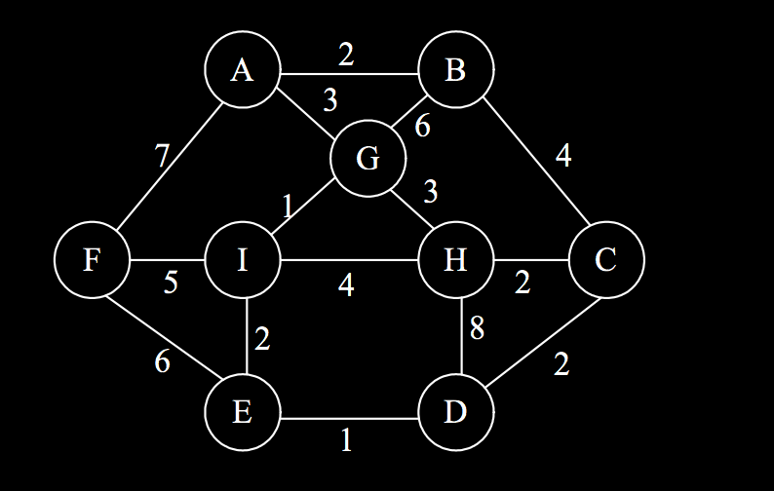
Routeplanning

Slide 2
Routeplanning
Determine for each piece of road:
  - Wether we can drive on it
  - The cost of driving on it
Build a graph – what roads are connected
Find the cheapest way from A to B

Slide 3
Routeplanning: cost of a road
Our routeplanner uses aspects which are combined
Can we acces this road? Is it oneway?
What is the (legal) maxspeed?
How comfortable is a segment?
How safe feels the road?
How fast does an average cyclist go?
Is it part of a network?
...

Slide 4
Access of a road
Can I access the road with <vehicle>?
access=yes/no/private/permissive/customers
bicycle=yes/no/private/permissive/customers
foot=yes/no/private/permissive/customers
motor_vehicle=yes/no/permissive/destination/customers

Slide 5

Access of a road
motor_vehicle=destination
bicycle=yes

Slide 6
Access of a road
motor_vehicle=destination
bicycle=yes
speed_pedelec=no

Slide 7
Access of a road
motor_vehicle=destination
bicycle=yes
speed_pedelec=yes
P

Slide 8
Oneway of a road
Can I travel the road in two directions with <vehicle>?
oneway=yes / no / -1
oneway:bicycle=yes/no

Slide 9

Oneway of a road
oneway=yes

Slide 10
Oneway of a road
oneway=yes
oneway:bicycle=no

Slide 11
Cycleway classifications
Map it as a seperate cycleway?
Or map is attribute on the road

Slide 12

Cycleway classifications
Seperate cycleway if there is at least one meter between the road and the cycleway
In the case of D07 “Verplicht fietspad”:
The main road for cars is not allowed for bicycles
  bicycle=use_sidepath

Slide 13
Cycleway classifications
Add a cycleway=* tag onto the main road in the case of
“Moordstrookje”: cycleway=lane
Fietssuggestiestrook/sharrow/: cycleway=shared_lane
With the bus: cycleway=shared_bus_lane
Separate track: cycleway=track
  The line between cycleway=track and drawing it
  is thin

Slide 14
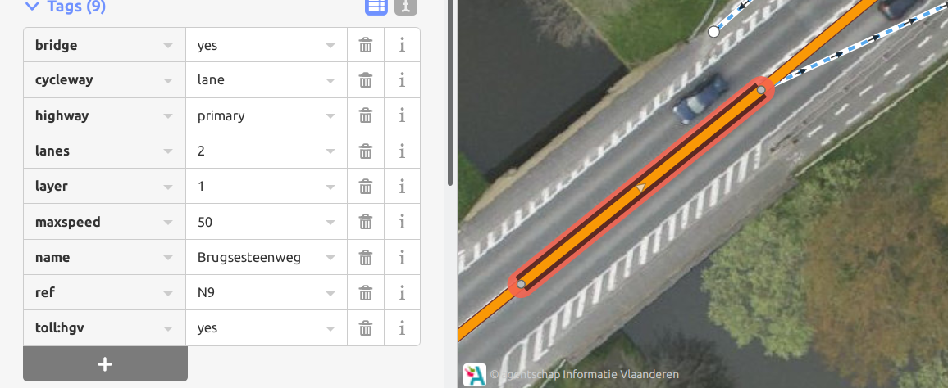

Slide 15
Cycleway classifications
Track vs. lane vs. seperate drawing… use your judgement
There are areas where `cycleway=track` is on the main road,
others where it is drawn seperately

Slide 16
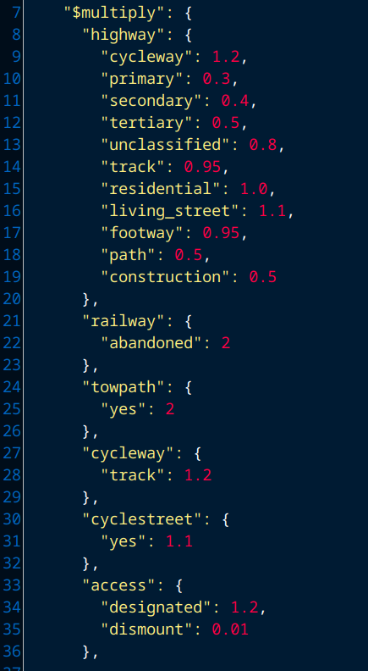
How comfortable is a segment?

Slide 17
Routeplanning: cost of a road

Slide 18
Help! The proposed route I’ve gotten is not what I want it to be!
Check the data. Is everything tagged correctly?
Is a link missing?
(Changes take some time to be picked up by routeplanners)

Slide 19
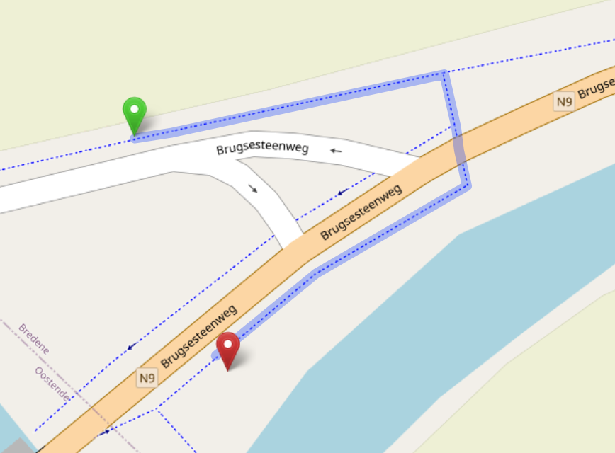

Slide 20
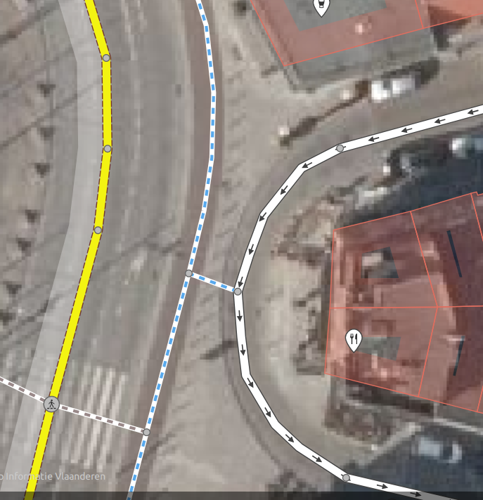

Slide 21
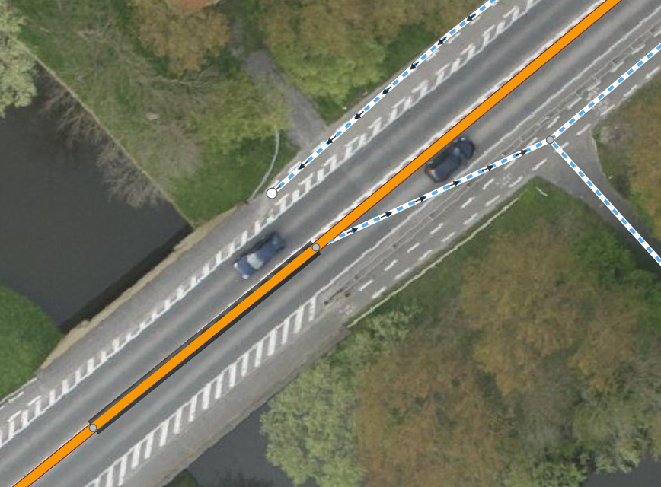

Slide 22
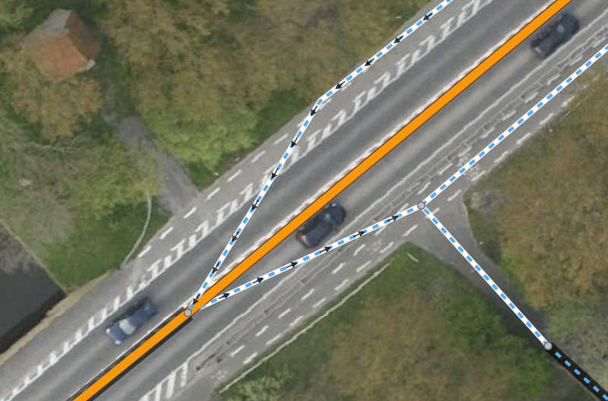

Slide 23
Help! The proposed route I’ve gotten is not what I want it to be!
Check the data. Is everything tagged correctly?
Is a link missing?
(Changes take some time to be picked up by routeplanners)
Ask help from others (e.g. Thierry)
Try another profile
Change the profile

